Slide 1
Chapter 1: Embedded Systems
Stellaris® CortexTM-M3 - Microcontroller family
Texas Instruments
Texas Instruments - University Program
Heilbronn University, Campus Künzelsau
Prof. Dr.-Ing. Ralf Gessler Rev. 1.0

Slide 2
Content
Chapter 1: Embedded Systems 1.1 Introduction and microcontrollers 1.2 Embedded ARM® and Stellaris® Family
Topics: ARM® series, CortexTM-M3, Thumb-2, Stellaris® family

Slide 3
Learning Objectives
This chapter describes the basics (theory) of the ARM® based Stellaris® family and the CortexTM-M3 core
Structure and questions:
What is ARM®?
Why ARM® and CortexTM-M3?
What is the Stellaris® microcontroller family?
What are features and advantages of Stellaris® devices?
What are typical Stellaris® applications?
What are the differences between Stellaris® and other TI families?

Slide 4

ARM® Overview
Advanced Risc Machine (ARM®) is a leading semiconductor Intellectual Property (IP) company and an architecture for the Digital World
Over 18 billion ARM® technology based chips shipped to date
Unrivalled Partner ecosystem
Over 660 processor licenses sold to more than 220 companies
Millions of developers; billions of users
ARM® has the right technology - optimized for a mobilizing world
Source: ARM®; [2]

Slide 5
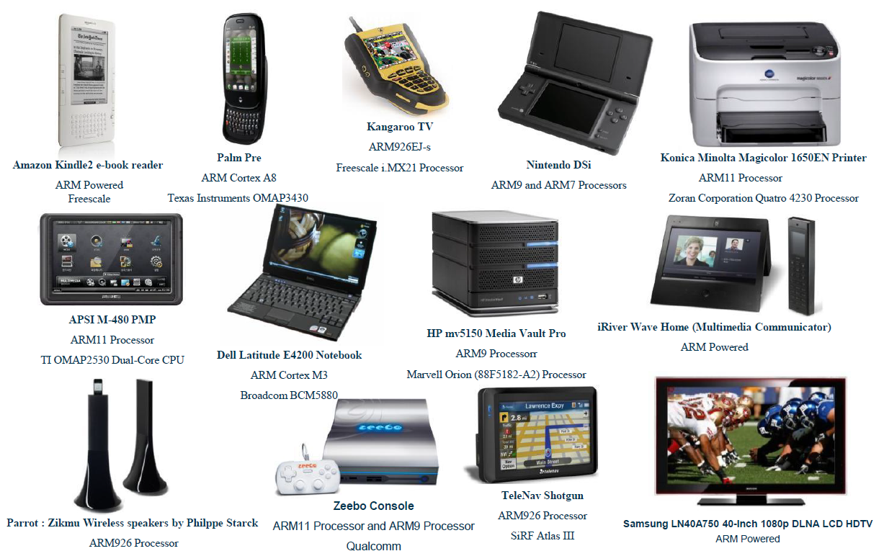
ARM® Embedded Systems
~4 Billion ARM® Processors Each Year
Source: ARM®; [2]

Slide 6
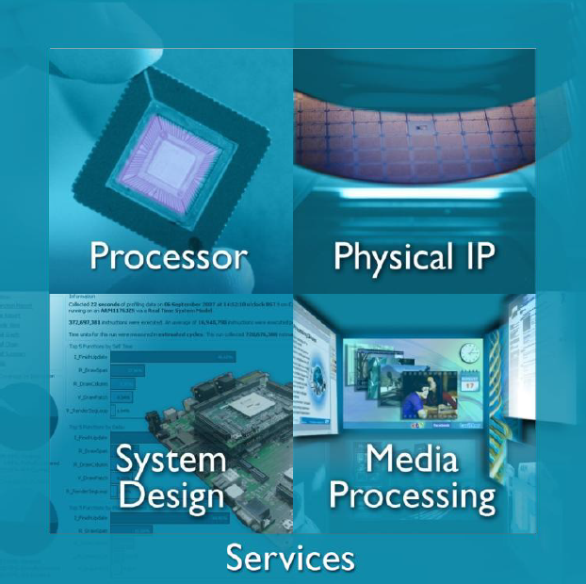
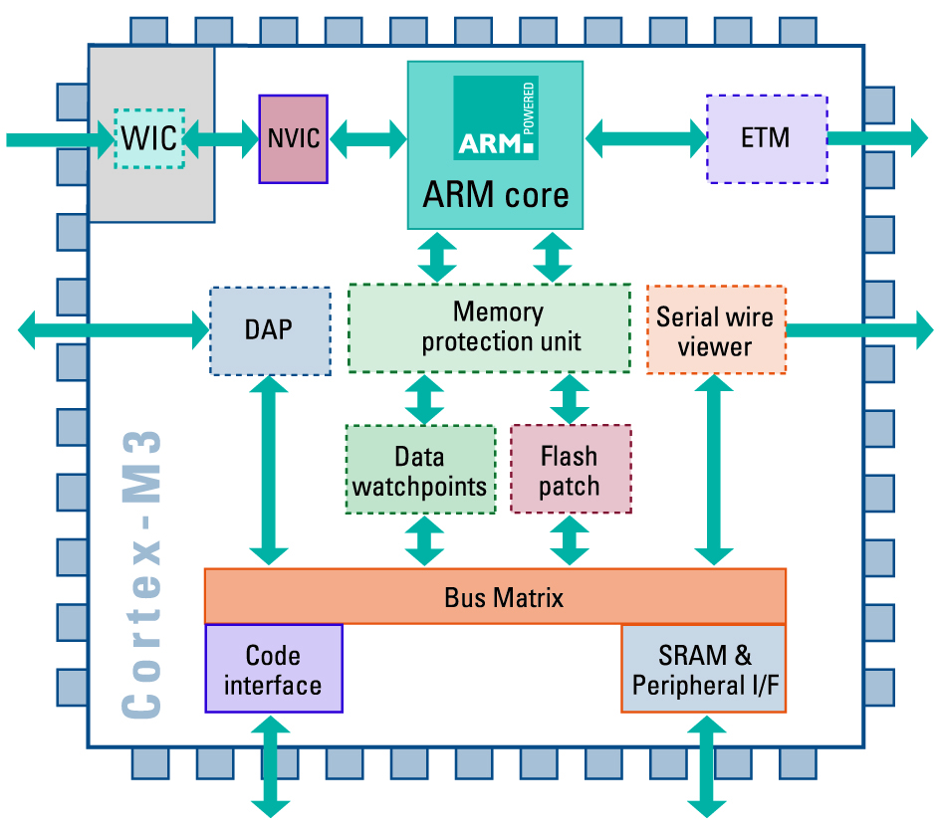
ARM® Embedded Systems
Advanced digital products are incorporating more and more ARM® technology - from processor and multimedia IP to SW
Processor Intellectual Properties (IP) - Design of the brain of the chip → SOC (System On a Chip)
Physical IP - Design of the building blocks of the chip
Multimedia - Graphics Processing Unit (GPU) to High Density (HD) Video
Software development tools
IP
SOC
Source: ARM®; [2]

Slide 7
Evolution ARM® processors
Architecture
v4/v4T
Architecture
v5/v5E
Architecture
v6
Architecture
v7
v7-A: Application
e.g. Cortex-A8
v7-R: Real Time
e.g. Cortex-R4
v7-M: Microcontroller
e.g. CortexTM-M3
Processors:
ARM® 7TDMI,
920T,
Intel StrongARM
ARM® 926,
946, 966
Intel XScale
ARM® 1136,
1176,
1156T-2
Source: [4]

Slide 8
CortexTM-M3 Processor
Technical Excellence:
Optimal performance, high efficiency processor core 1.25 DMIPS/MHz
Rich, unified Thumb-2 high performance instruction set → Smallest code size and reduced memory requirements
Low latency, integrated Nested Vectored Interrupt Controller (NVIC)
Sophisticated debug and trace support
Memory Protection Unit (MPU)
Embedded Trace Macrocell (ETM)
Advanced power management features and capabilities
Fault Robust Interface
Integrated bus matrix for increased performance

Slide 9
CortexTM-M3 Processor
Feature
Summary
Wake-Up Interrupt Controller:
Low gate count Configurable Number of Interrupts
Suitable for separate power domain
Configurable Interrupt Controller:
1:240 Interrupts
1:255 Priority Levels
NMI & SysTick
Central Core:
1.25 DMIPS/MHz
Thumb-2 / Thumb ISA
Hardware Divide
1 cycle Multiply
ETM (Optional)
MPU (Optional)
8-Region Memory Protection Unit
ITM (Optional)
Low-cost trace via single wire output
Debug Access Port: JTAG or Serial Wire
FPB (Optional)
8x Hardware Breakpoints w. program patching
DWT (Optional)
4x Data Watchpoints & Event Monitors
2x AHB-Lite Buses
I_CODE (Instruction Code Bus)
D_CODE (Data / Coefficients Code Bus)
1x AHB-Lite Buses
SYSTEM (SRAM & Fast Peripherals)
1x APB Bus
ARM Peripheral Bus (Internal & Slow Peripherals)

Slide 10
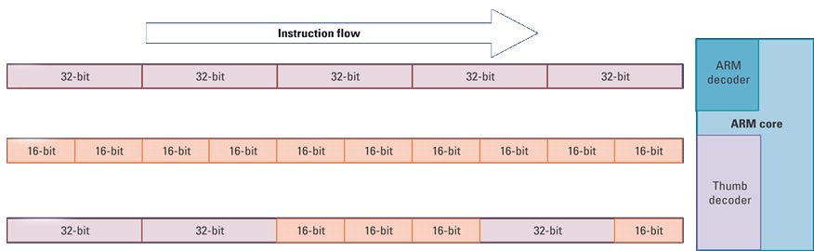
Thumb-2 Technology
Thumb-2 ISA was introduced in ARMv7 architecture
Original16-bit Thumb instructions maintain full compatibility with existing code +
New 16-bit Thumb instructions for improved program flow +
New 32-bit Thumb instructions for improved performance and code size.
One 32-bit instruction replaces multiple 16-bit opcodes.
32-bit instructions are handled in the same mode ~ no interworking required
ARM
Thumb
Thumb-2

Slide 11
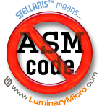
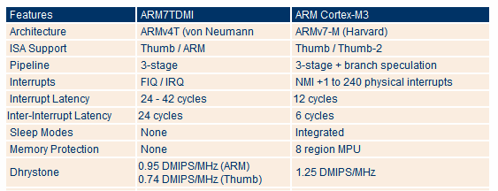
CortexTM-M3 core: Benefits
Capabilities beyond ARM7TDMI for the MCU market
No Assembly Required!
Cortex-M3 requires approximately half the Flash-memory of ARM7 implementations
2-4 times faster on MCU control applications
Raw interrupt performance: 85% faster
PID (process control) main loop: 217% faster
Multiply-intensive code: 294% faster
Divide-intensive code: 726% faster
Note: Dhrystone MIPS (DMIPS); Million Instructions Per Second (MIPS)

Slide 12
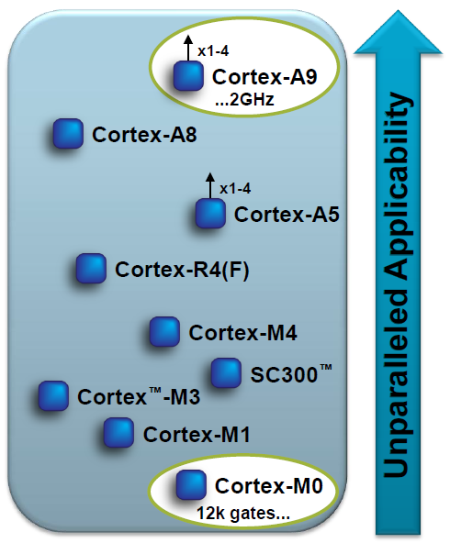
ARM® series: CortexTM -M core
ARM® CortexTM provides a range of solutions
Different series aligning technology around specific applications
3 series implementing the Thumb-2 instruction set:
ARM® Cortex-A Series
ARM® Cortex-R Series
ARM® CortexTM -M Series
ARM® Cortex-A Series
Applications processors for complex OS and user applications.
Supports the ARM, Thumb and Thumb-2 instruction sets
ARM® Cortex-R Series
Embedded processors for real-time systems.
Supports the ARM, Thumb, and Thumb-2 instruction sets
Source: ARM®; [2]

Slide 13
ARM® series: CortexTM -M core
ARM® CortexTM -M Series
Deeply embedded processors optimized for cost sensitive applications.
Supports the Thumb-2 instruction set only
Note:
ARM® Code 32-bit
Thumb Code 16-bit
Thumb-2 Code mostly 16-bit and some 32-bit (25% Faster, 26% Smaller)

Slide 14






Application range
Forget traditional 8/16/32-bit classifications
Seamless architecture across all applications
Every product optimised for ultra low power systems
Cortex-M0
CortexTM -M3
Cortex-M4
“8/16-bit” applications
“16/32-bit” applications
“32-bit/DSC” applications
Lowest cost
Optimised connectivity
Performance efficiency
Feature rich connectivity
MCU plus DSP
Accelerated SIMD, FP & DSP

Slide 15
CortexTM -M3 features
Instruction Set: Thumb2
Word length: 32 bit
Architecture: Harvard (ARMv7-M)
Registers: 13 general purpose, 1 Stack Pointer, 1 Link Register, 1 Program Counter, 1 Program Status, Special Registers
Benchmark: 1.25 DMIPS/MHz (Dhrystone MIPS)
Interrupt-Latency: 12 Cycles

Slide 16
CortexTM -M3 features (cont.)
Energy consumption: 0.19 mW/MHz
Area [5]: 0.86mm² (Core and Peripherals)
Note: Does not include optional system peripherals (MPU & ETM) or integration level component
Features: NVIC, Sleep modes, MPU, Bit-Banding, Debug functionality
Remember: RISC, Harvard-Architecture
Link: See Chapter 1.1 “Introduction and microcontrollers”

Slide 17
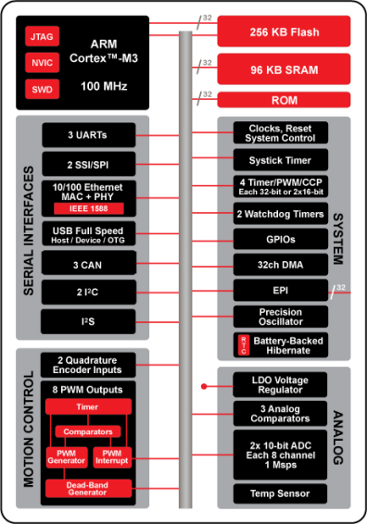

Stellaris® Family Overview
Developed
by ARM
80 MHz
Developed
by TI

Slide 18
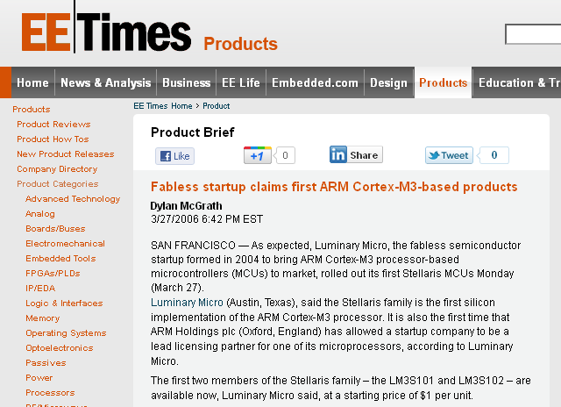
First ARM® CortexTM-M3 MCU
In May of 2009, TI acquired Luminary Micro, Inc.
Luminary Micro was ARM’s lead partner for CortexTM-M3 architecture, bringing first CortexTM-M3 MCU to the market in March 2006
TI now offers four generations of Stellaris® ARM® CortexTM-M3 MCUs - over 180 microcontrollers!
2
6
19
24
51
85
104
128
138
180
Stellaris
Sandstorm Class
Stellaris
Fury Class
Stellaris
Dust Devil Class
Stellaris
Tempest/Firestorm Class
MAY 2006
JUL 2006
FEB 2007
JUN 2007
SEP 2007
DEC 2007
APR 2008
NOV 2010
MAR 2006
JUNE 2010

Slide 19
Stellaris® family
Stellaris® is the industry’s leading family of robust, real-time microcontrollers (MCUs)
Based on the revolutionary CortexTM -M3 technology from ARM®.
The Stellaris® 32-bit MCUs combine sophisticated, flexible mixed-signal system-on-chip integration with real-time multitasking capabilities. Capable of complex applications previously impossible with older devices.
MCUs can now be accommodated with ease by powerful, cost-effective and simple-to-program Stellaris® MCUs.
With over 160 members in its family, the Stellaris® family offers the widest selection of compatible MCUs in the industry.

Slide 20
Stellaris® family: applications
The Stellaris® family is positioned for cost-conscious applications requiring significant control processing and connectivity capabilities
Including motion control, monitoring (remote, fire/security, etc.), HVAC and building controls,
Power and energy monitoring and conversion, network appliances and switches,
Factory automation, electronic point-of-sale machines, test and
Measurement equipment, medical instrumentation, and gaming equipment.

Slide 21
Why ARM® architecture?
For the first time ever, embedded microcontroller system designers can utilize 32-bit performance for the same price as their current 8- and 16-bit microcontroller designs!
With entry-level pricing at $1.00 for an ARM® technology-based MCU, the Stellaris® product line allows for standardization that eliminates future architectural upgrades or software tools changes.
With an ARM® -based embedded market that is currently shipping at a rate of greater than 4.6 billion processors per year, the ARM ecosystem of third-party tools and solutions providers is the largest in the world.
With the ARM® CortexTM architecture, designers have access to an instruction-set-compatible family that ranges from $1 to 1 GHz.

Slide 22
Why choose CortexTM -M3?
CortexTM -M3 is the MCU version of ARM®’s V7 instruction set architecture family of cores:
Optimized for single-cycle flash usage
Deterministic, fast interrupt processing: always 12 cycles, or just 6 cycles with tail-chaining
Three sleep modes with clock gating for low power
Single-cycle multiply instruction and hardware divide
Atomic (un-interruptible) operations
ARM Thumb2 mixed 16-bit/32-bit instruction set
1.25 DMIPS/MHz - better than ARM7 and ARM9
Extra debug support including data watch points and flash patching
Capabilities beyond ARM7TDMI for the microcontroller market:
Requires approximately 1/2 the flash (code space) of ARM7 applications
2 - 4 times faster on MCU control applications
Assembly code is not normally required.

Slide 23
Why the Stellaris® Family?
Designed for serious microcontroller applications, the Stellaris® family provides the entry into the industry’s strongest ecosystem, with code compatibility, ranging from $1 to 1 GHz.
Superior integration saves up to $3.28 in system cost
Over 160 Stellaris® family members to choose from
Real MCU GPIOs - all can generate interrupts, are 5V-tolerant, and have programmable drive strength and slew rate control
Advanced communication capabilities, including 10/100 Ethernet MAC/PHY, USB and USB OTG, CAN controllers, and extended peripheral interfaces
Sophisticated motion control support in hardware and software
Both analog comparators and ADC functionality provide on-chip system options to balance hardware and software performance
Development is easy with the royalty-free StellarisWare® software

Slide 24


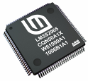

Stellaris® family: overview
Over 160 family members
20, 25, 50, 80, and 100 MHz
8K to 256K Flash
2K to 96K SRAM
48-LQFP
64-LQFP
100-LQFP
and 108-BGA
Industrial & Extended Temperature
80 MHz

Slide 25
Stellaris® family: product lines
LM3S1nnn non-CAN, non-Ethernet
LM3S2nnn CAN
LM3S3nnn USB
LM3S5nnn CAN + USB
LM3S6nnn Ethernet
LM3S8nnn Ethernet + CAN
LM3S9nnn Ethernet + CAN + USB
„low cost“
„high“
specification

Slide 26
Questions and Exercises
What is an Embedded System?
What is a RISC machine?
Compare a RISC with a CISC machine.
Explain the abbreviation IP and a SOC.
Why is the Stellaris® family useful for Embedded Systems?
Explain Thumb and Thumb-2 instruction set.
Calculate the energy consumption of a CortexTM-M3 core, running at 50 MHz.

Slide 27
Summary and Outlook
Summary
From microcontrollers to ARM® family
From ARM®x Family to CortexTM -M3 core
From CortexTM -M3 core to Stellaris® family
Outlook/How to go on?
Lets have a closer look to the Stellaris® family architecture

Slide 28
References
[1] Henri, G.; Texas Instruments: MCU Training Module - ARM ® Cortex M3/M4 cores. EMEA; Oct. 07, 2010.
[2] TI Stellaris® Team; Owen, R.: ARM-Material I. ARM-TI_Workshop_2010_Processor_Architecture_and _Implementation[1].pdf, 2011.
[3] Texas Instruments: Stellaris® Family of Microcontrollers. slab054b(.pdf), 2009.
[4] Yiu, J.: The Definitive Guide to the ARM Cortex-M3. Elsevier Inc., 2007, ISBN: 978-0-7506-8534-4.
[5] Sadasivan, S.: An Introduction to the ARM ® CortexTM -M3 Processor. ARM White Paper, Oct. 2006.
[6] TI Stellaris® Team; Dobes, I.: “Stellaris® History”. Stellaris® History.pptx, 2011.

Slide 29
References
[7] TI Stellaris® Team; Owen, R.: ARM®-Material II. ARM® Teaching Material.ppt, 2011.
[8] TI Stellaris® Team; Owen, R.: Cortex^{®TM}-M3. CortexM3_Uni_Intro_Short.pdf, 2011.
[9] TI Stellaris® Team; Borgeson, J.: “MCU-Story”. MCU_story.ppt, 2011.
[10] TI Stellaris® Team; Borgeson, J., “Stellaris ®-Market”. Stellaris_ROM_MarketSlide_JB.ppt, 2011.

